Slide 1



The long-period orbit of the dust-producing Wolf-Rayet binary WR 125
Andrea Daly
Noel Richardson

Slide 2
Objective
Recently the binary system WR 125, WC7+O, began a dust creation episode seen with an infrared outburst.
This is the first time since 1991 that this type of activity has been observed for WR 125, leading to the first determination of a period: 28.1 years.
We began collecting spectra of WR 125 to constrain the orbit, on the assumption that this system will produce dust near periastron, similarly to WR 140.

Slide 3
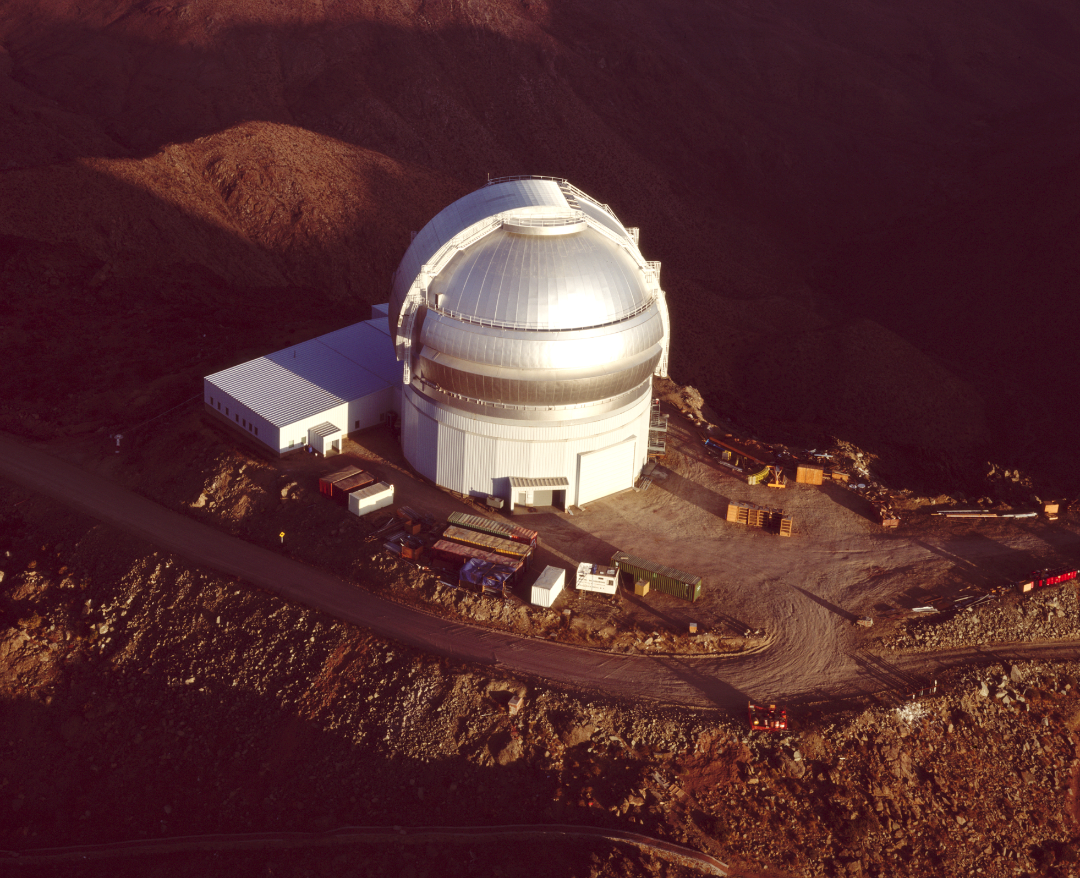
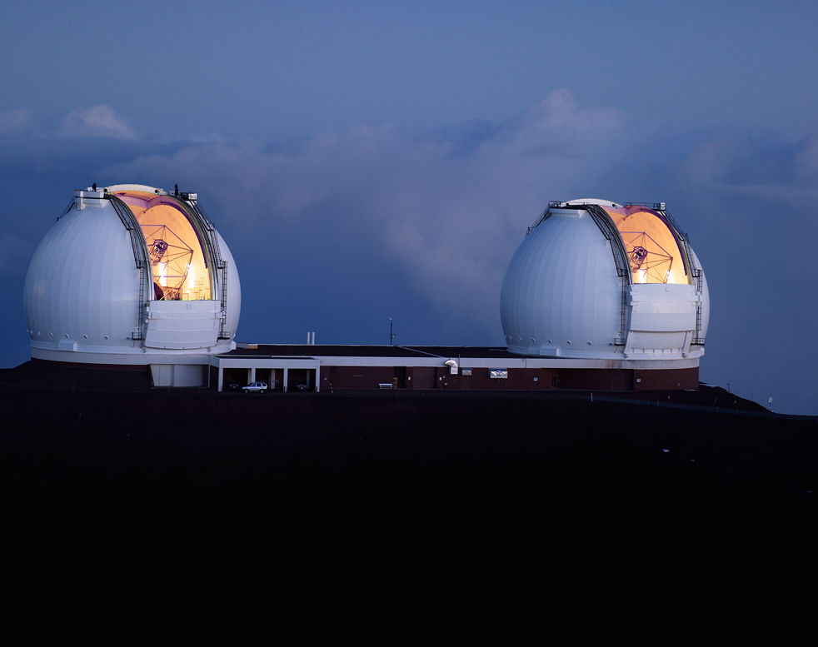
Data
Gemini Observatory
(https://www.gemini.edu/)
We have gotten our data from the Gemini Observatory and the Keck Observatory both located in Hawaii
Keck Observatory
(https://keckobservatory.org/)

Slide 4

Upcoming data
We were recently granted time on SOFIA (the Stratospheric Observatory for Infrared Astronomy) and hope to begin reducing and analyzing the data soon
SOFIA observed the dust of WR 125
SOFIA
(https://www.nasa.gov/mission_pages/SOFIA/overview/index.html)

Slide 5
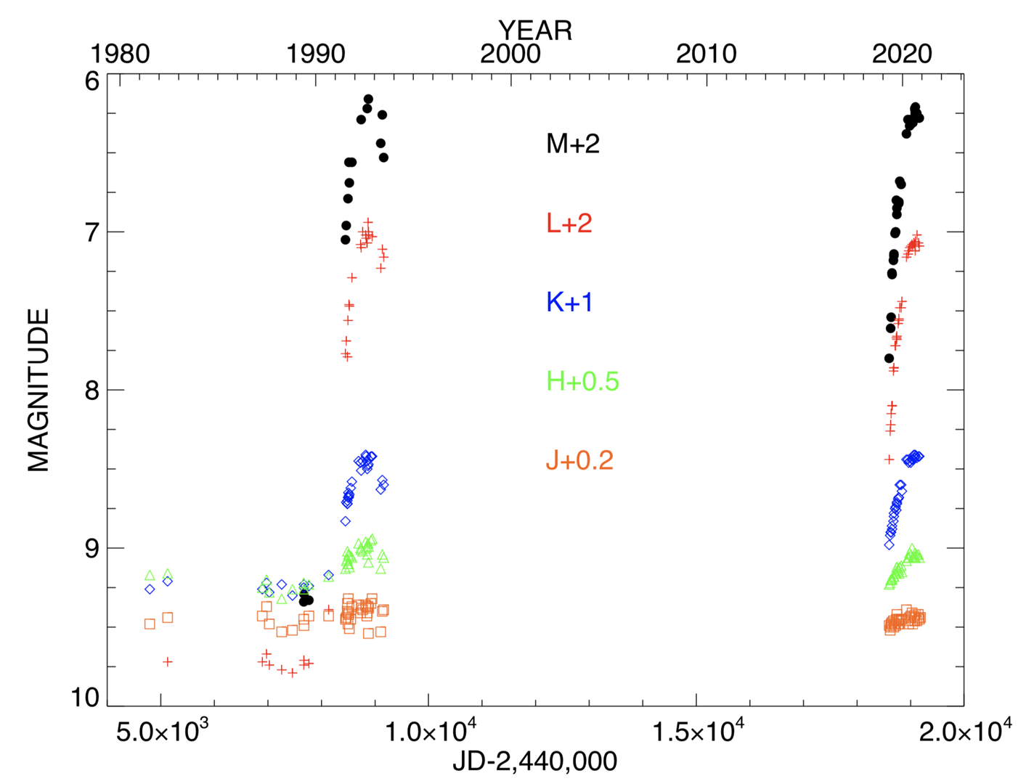
Infrared Light Curve
The long-term infrared variability of WR 125 in JHKLM bands.
The pronounced infrared bumps are dust creation episodes. A time-series analysis has led to a presumed period of 28.1 years.

Slide 6
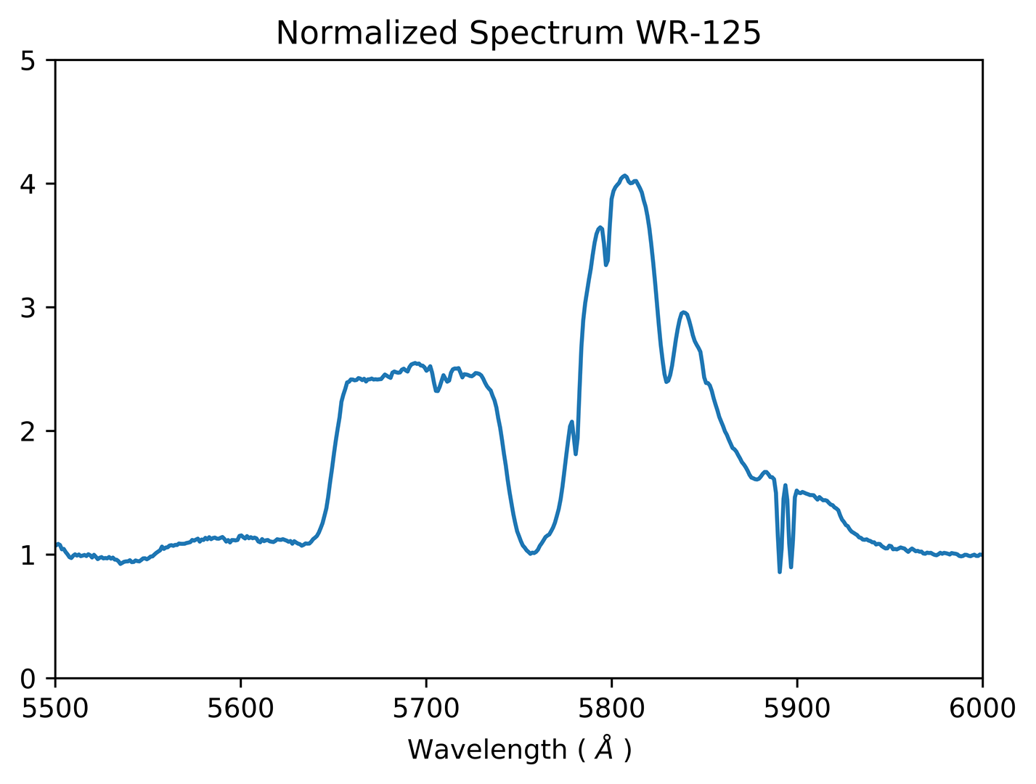
Spectrum
Here we have the normalized spectrum of WR 125 taken with Gemini/GMOS (Gemini Multi-Object Spectrographs)on 2020-05-31.

Slide 7
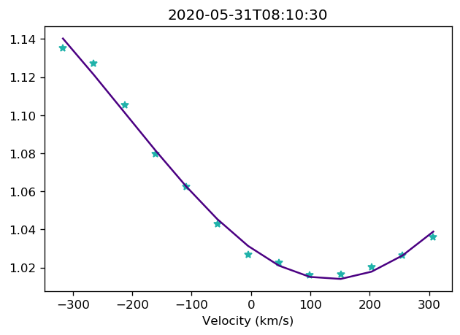
Gaussian fits for the O Star
Gaussian fit of the He I 5875 absorption line from the O star
These fits have been at He I lines at 5875 angstroms.
Hydrogen lines have proved to be too noisy

Slide 8
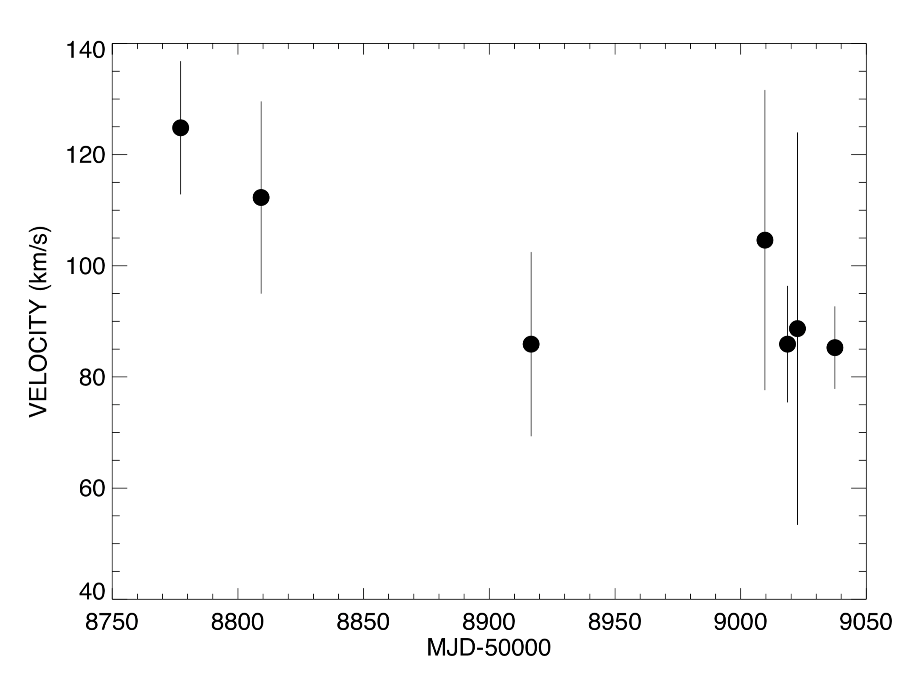
Initial Radial Velocities
The first measured radial velocities for the system to begin constraining the orbit
We are able to begin seeing some velocity shifts in the system.

Slide 9
Where to go from here
Continue to work through the O star gaussian fits at the He I lines in the spectrum
Start analysis in the Keck data
Begin reducing and analyzing the SOFIA data when we get it
Measuring bisector velocities for the WR star
Plot the orbit from the radial velocities that we find

